Slide 1
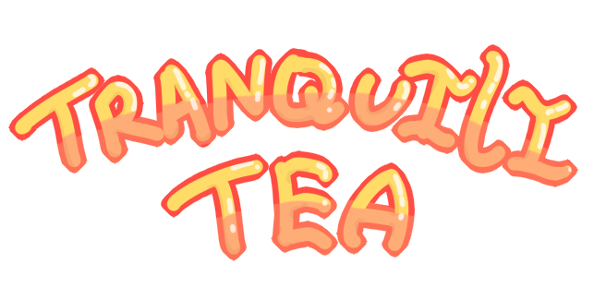
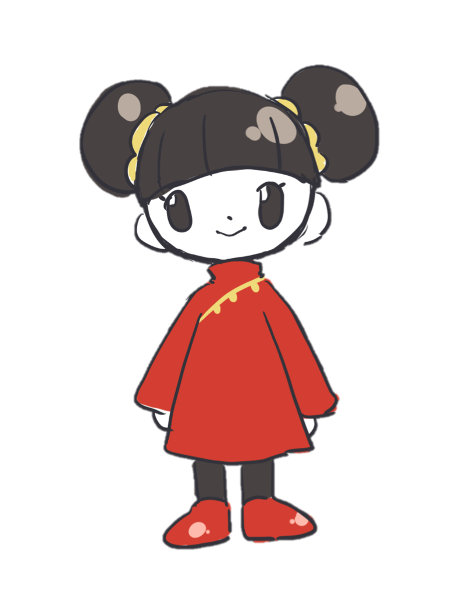
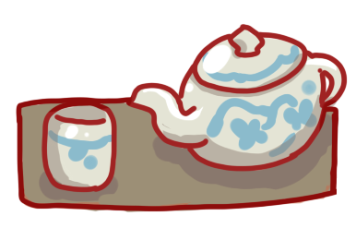
Ashley Vargas, Karina Vargas,
Christina Cuneo, and Rachel Lau
Notes:
Ashley

Slide 2
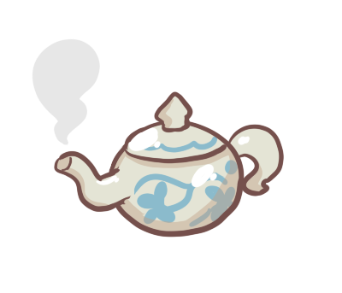
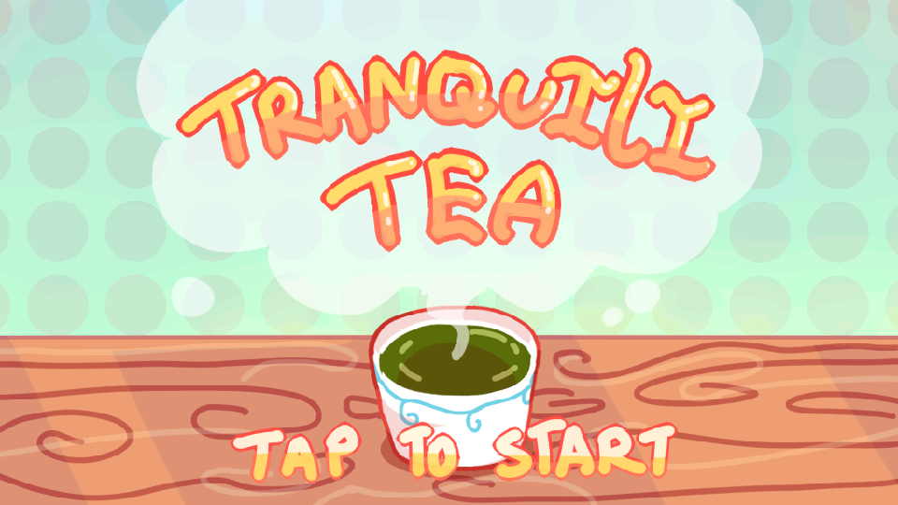
What is Tranquilitea?
A tea mixing game!
Combine different ingredients to create and unlock information on Chinese teas.
Notes:
Ashley

Slide 3
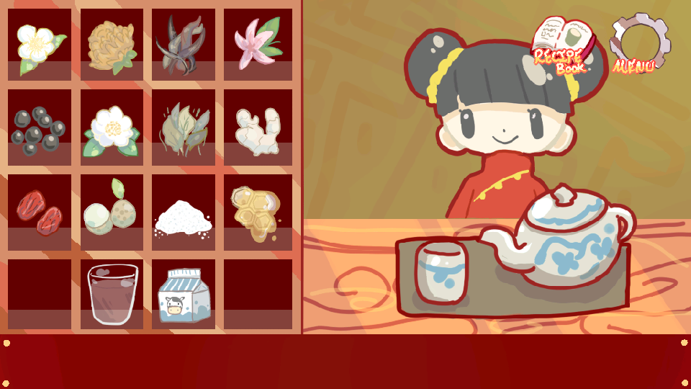
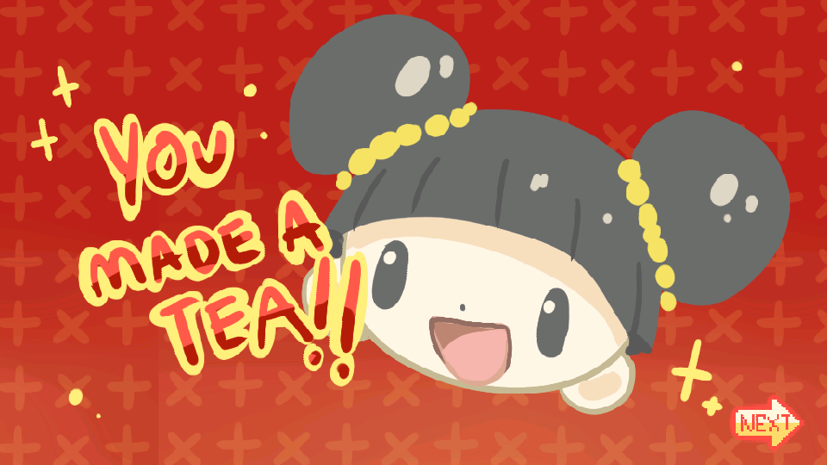
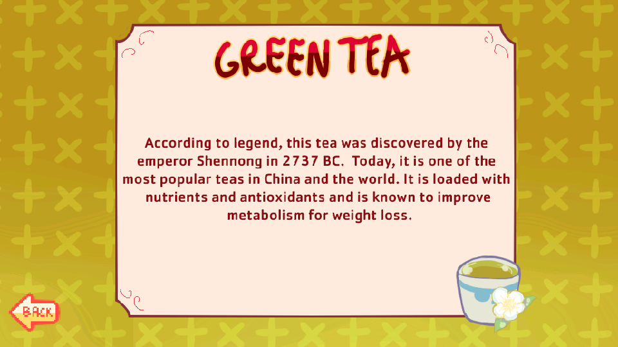
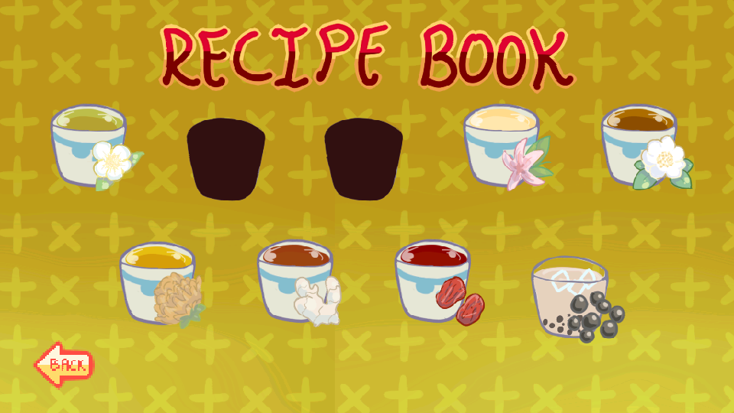
Screenshots of our app
Notes:
Ashley

Slide 4
Motivation
Our project had to be related to Chinese culture in some way.
We wanted to make an app that is fun and interactive to learn about the Chinese culture.
Notes:
Rachel

Slide 5
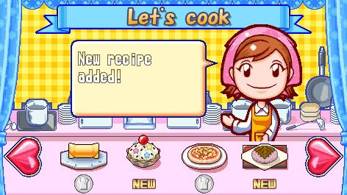
Who and Why?
Anyone, from kids to adults.
More specifically, anyone who is curious about Chinese teas.
Marketwise, we looked at games such as Professor Layton and Cooking Mama for inspiration.
Rated E for Everyone, in ESRB rating.
Notes:
Christina
We aimed to have this game be fun and accessible for anybody, et cetera et cetera

Slide 6
Content
Research - The whole team.
Art - All in-game art was made by Ashley and Karina
The team sketched and designed ideas.
Christina created the app’s icon.
Music - The royalty free background music was created by もっぴーさうんど (Moppy Sound).
Sound effects- created by Karina.
Notes:
Karina

Slide 7
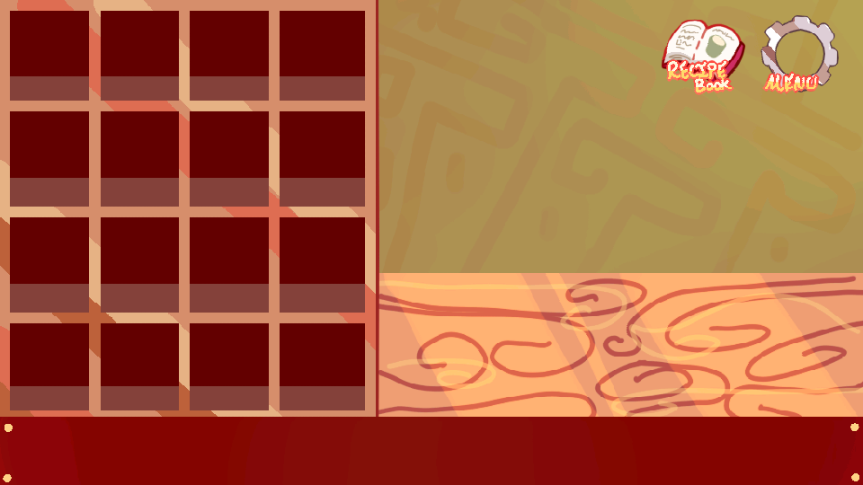
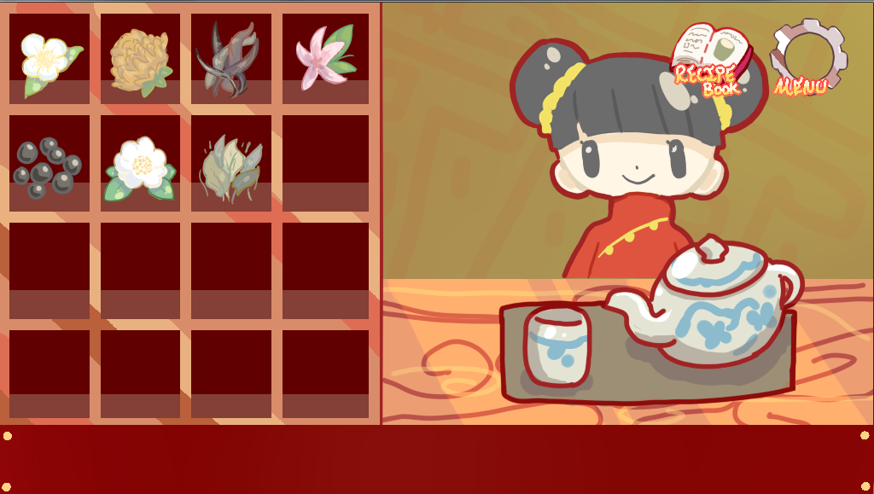
Process
Scrum as part of the Agile Methodology
Scrum Meetings, Planning, Demo, Retrospective
3 sprints, each lasting 2 weeks each.
User stories were divided amongst team members for each sprint and with each one we had a better sense of how much we could realistically accomplish.
Notes:
Rachel

Slide 8
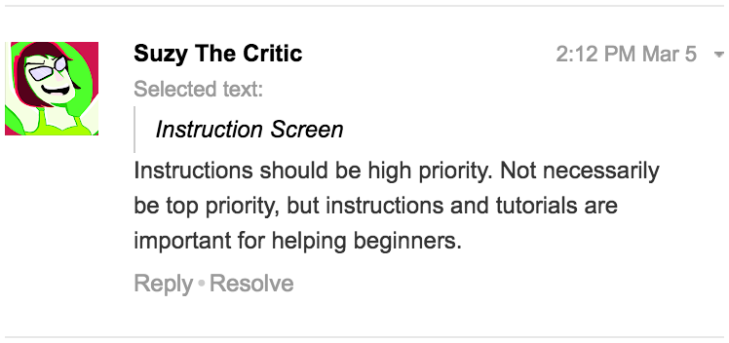
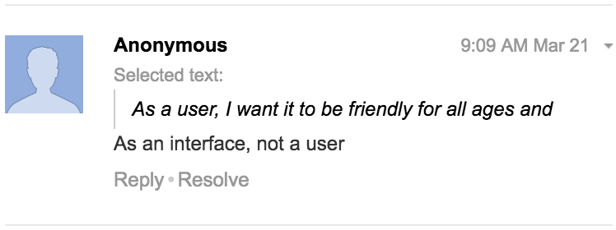
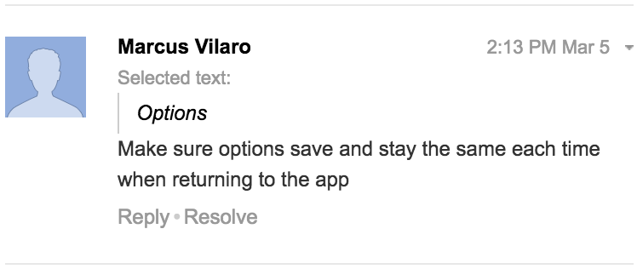
Requirements
To figure out our requirements, we thought of previous games we have played
We assumed what requirements were necessary
Recorded the requirements as 19 user stories on the product backlog
Backlog validation
Notes:
Ashley

Slide 9
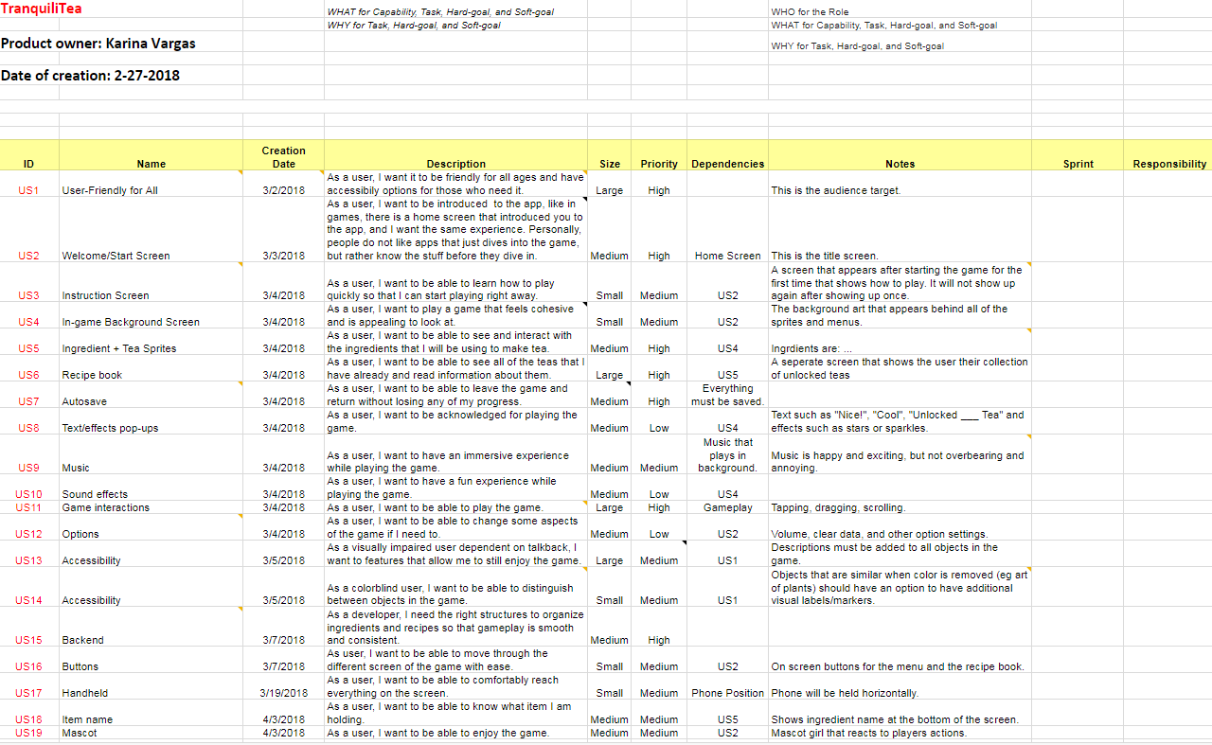
Product Backlog
Notes:
Karina

Slide 10
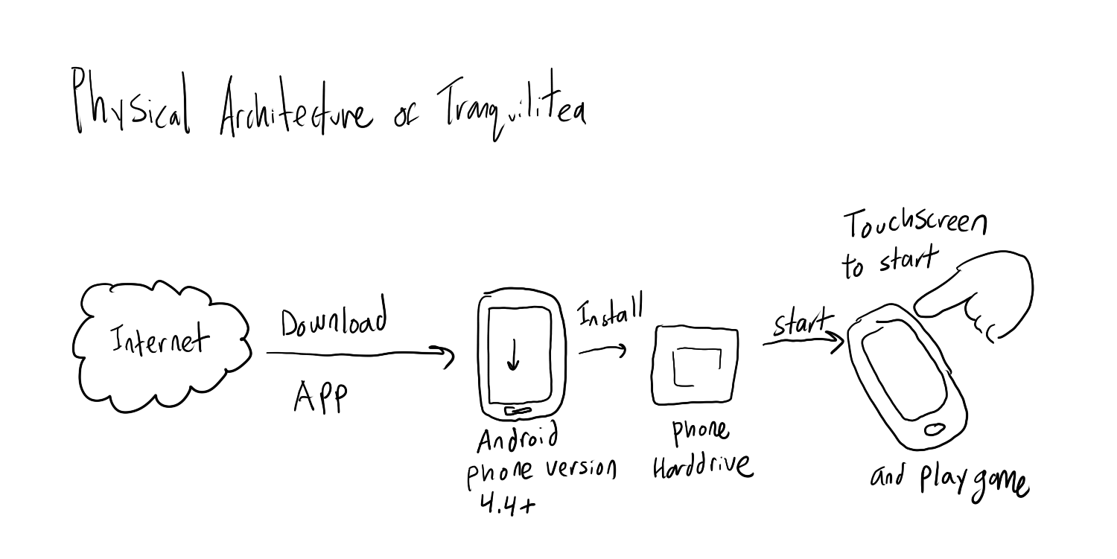
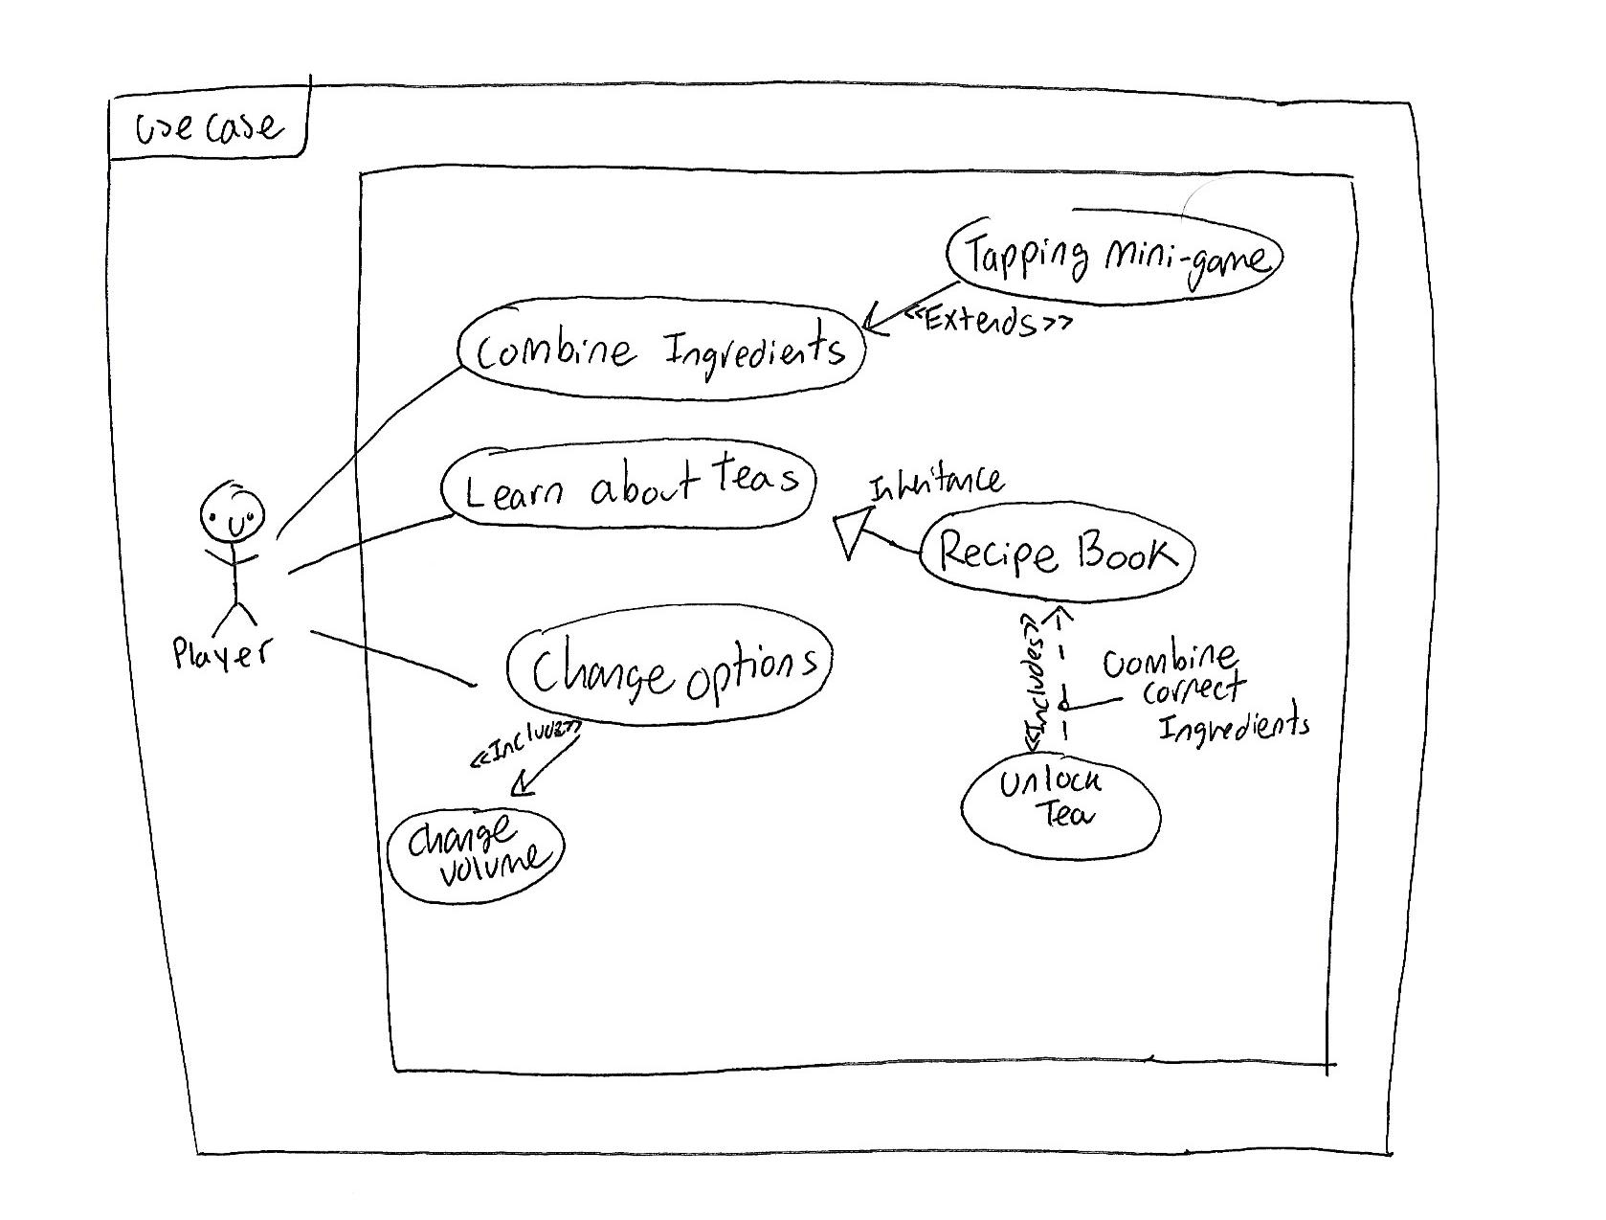
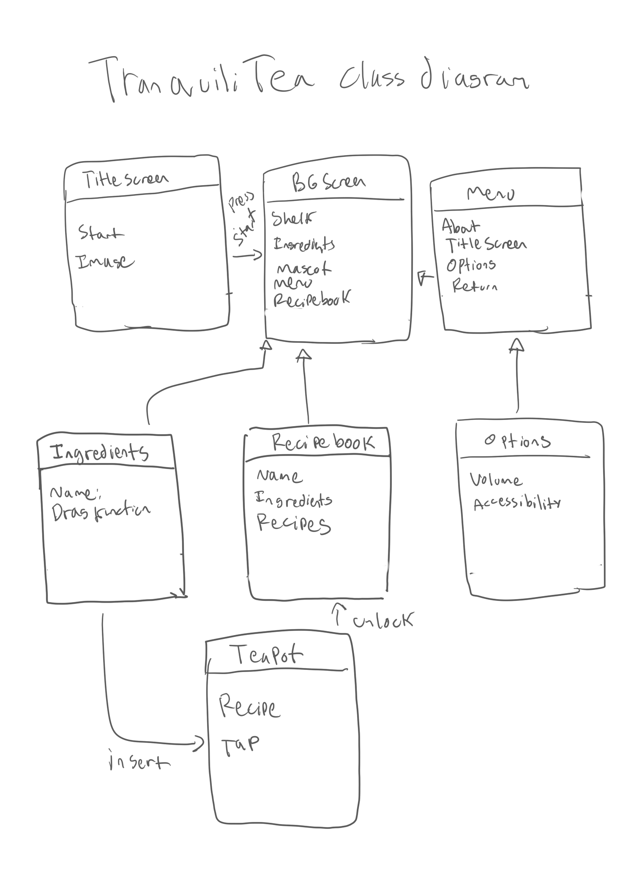
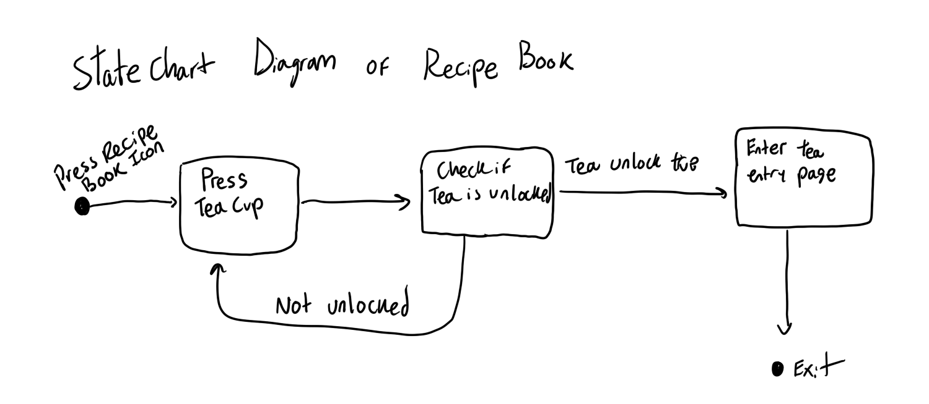
Architecture
Notes:
Ashley

Slide 11
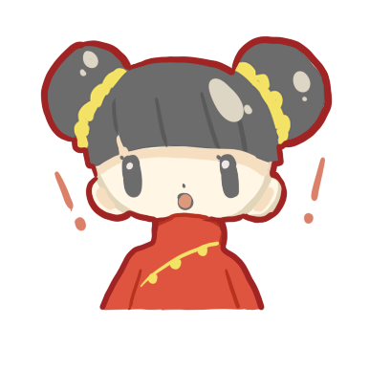
Live Demo!
https://www.youtube.com/watch?v=Si4aYedycC0&feature=youtu.be
Notes:
Ashley

Slide 12
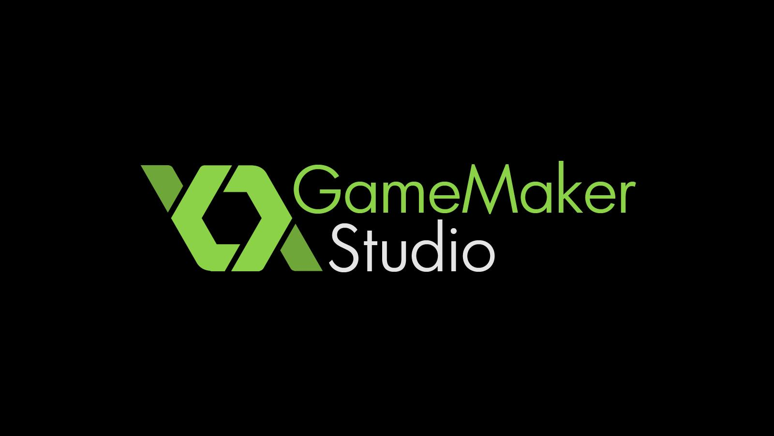


Tools - Development
Notes:
Ashley

Slide 13



Tools - Art
Notes:
Christina
Most of the in-game art was done in PaintTool SAI, but we also used Photoshop and Illustrator for some parts, as well as for the icon.

Slide 14
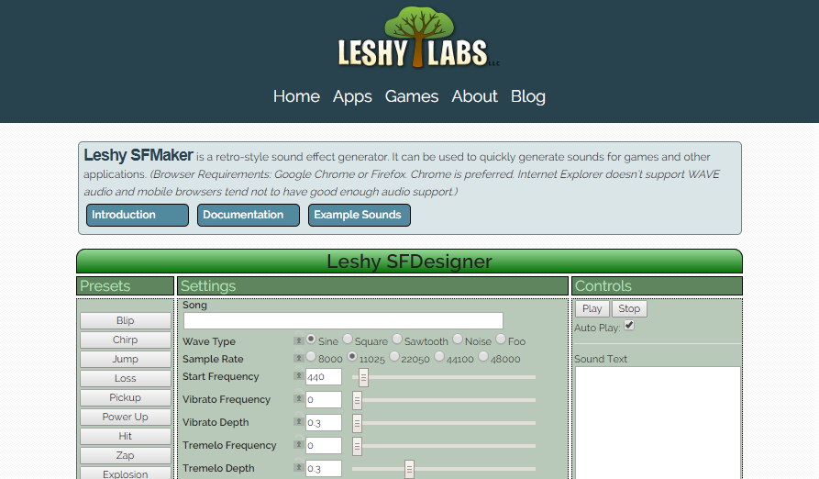
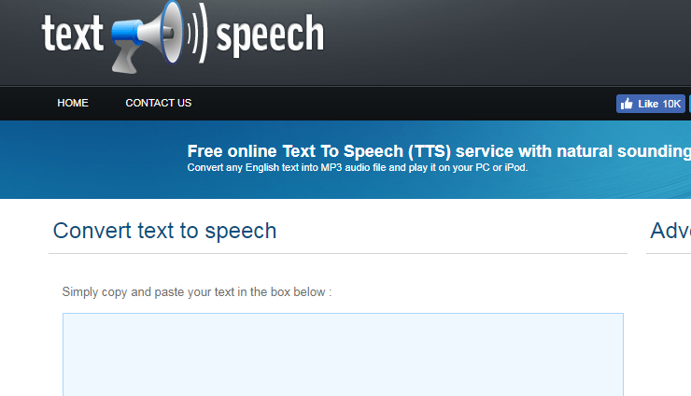

Tools - Sound
Notes:
Karina

Slide 15



Tools - Communication
Notes:
Rachel

Slide 16
Stats
4 Different methods of communication | 18 of 19 Total User Stories implemented | 150+ Total hours worked
71 Objects created | 18 Total Scrum Ceremonies | 450+ Messages
Notes:
Rachel

Slide 17
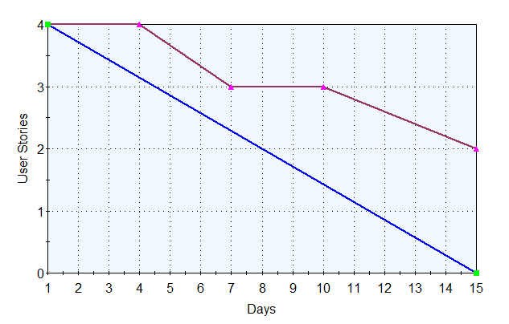
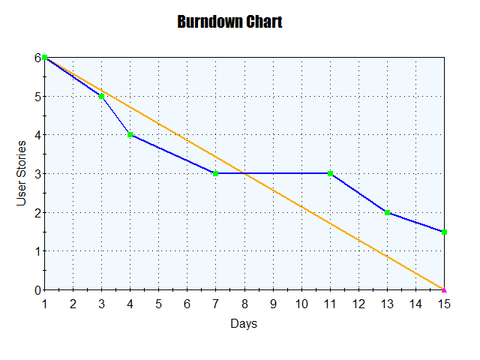
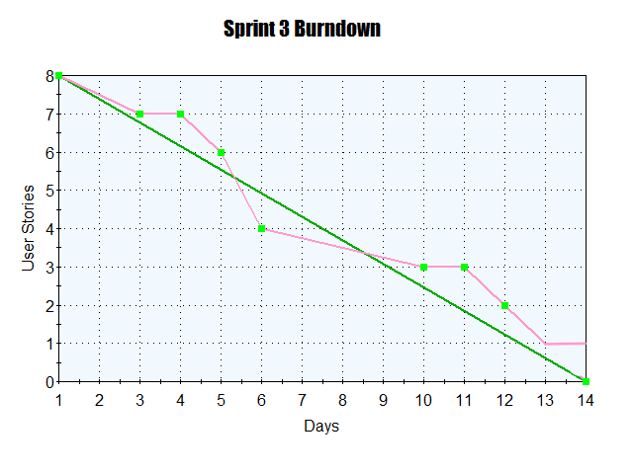
Burndown charts
Sprint 1
Sprint 2
Sprint 3
Planned stories: 6
(including 2 tasks)
Implemented stories: 4
Planned stories: 6
Implemented stories: 5
Planned stories: 8
Implemented stories: 7
Notes:
Karina

Slide 18
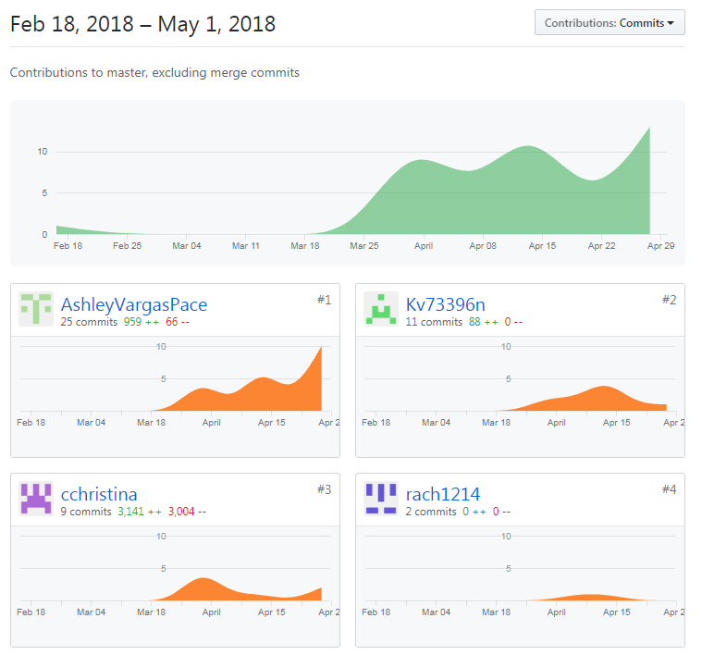
Github Statistics
Notes:
Rachel

Slide 19
Experience
We had a little bit of a difficult start due to the GameMaker licensure issues.
GameMaker also does not integrate with GitHub easily, so we had to develop a system of sharing object information to collaborate.
But overall it was a great learning experience.
Notes:
Christina
Talk about how Scrum required us to develop better time management skills
Also learning how to communicate effectively

Slide 20
What’s Next?
Polish the app.
Add autosave.
Hopefully even upload to the Google Play Store.
Notes:
Christina

Slide 21
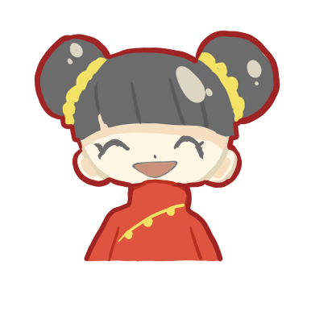
Thank you!

